Slide 1
Security Capture the Flag Competitions
2015 Ghost in the Shellcode - Pwn Adventure 3 challenge

Slide 2


Why should we care about Cyber Security
Cyber security has real life impacts
Media often present an unrealistic view of cyber security events.
Hacker cat – Don’t mess with him

Slide 3
Extract of security news articles in the last month:
US military Cyber Command claim that they have been deploying malware inside Russia grid and claim it can cripple Russia’s power network. ~The New York Times 15/6/2019
It has been revealed that customs in the Xinjiang region China are installing text-stealing malware at it’s border ~VICE 3/16/2019
A Florida city paid a $600,000 bitcoin ransom to hackers who took over their computers ~Business Insider 20/6/2019
The Iranian company Cellebrite claim they have found an exploit that can unlock any iPhone for the police force. ~WIRED 14/6/2019
plus around 60 other new worth events that took place around the world that can’t fit on this slide.

Slide 4

What is it?
Computer security competition
Make in 2015 for the Ghost in the Shellcode competition
Released to the general public in late 2015

Slide 5
How long did it take me to complete?
Competition designed to take 2 day for a team of cyber security professionals (i.e. people that know what they are doing)
It took me 5 months in total
Had to take 3 online courses to prepare
Introductory Intel x86: Architecture, Assembly, Applications, & Alliteration
Learn how to read 32 bit assemble instructions
Introductory Intel x86-64: Architecture, Assembly, Applications, & Alliteration
Learn how to read 64 bit assemble instructions
Introduction to Software Exploits (Exploits 1)
Learn of buffer and stack overflow attacks work

Slide 6
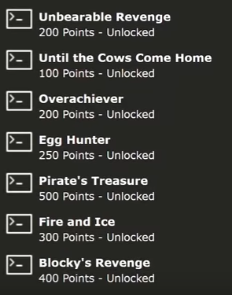
What do you actually do in the competition?
It is a Capture The Flag (CTF) style of competition
The goal is to collect 7 items in the game
Just like Horcruxes in Harry Potter

Slide 7
So collect the flags. How hard could that be….

Slide 8
Turns out it is pretty hard
Collect all 10 golden eggs in the game to get the Egg Hunter flag
The golden eggs are hidden in the game (e.g. in caves, behind buildings and in unreachable places)

Slide 9
What one of the eggs looks like:

Slide 10
How would you solve it? - High level solutions
Find the X, Y, Z coordinate of the eggs
Walk in the direction of the eggs
Collect them

Slide 11
But how can we do that?
When a game launches it will build the world and place objects into that world.
We can check the Initialization section of the game to see if it places the golden eggs into the world (spoiler it does).
We can then write down the X, Y, Z coordinates and then walk to each egg
We can use a disassembler such as Binary Ninja or IDA Pro to do this

Slide 12
Gotta Catch 'Em All!
Once we know where the eggs are -> can start collecting the eggs
But some eggs are not accessible (e.g. on a shelf too high to reach)
Could find a way to jump higher in the game
Or we could just teleport to the eggs.

Slide 13
Teleporting 101
Games are made up of variables. Variables can hold numbers.
There will be 3 variables in the game to hold the players X, Y and Z coordinates
If we can find these variables then we can try setting them to whatever values we want and see what happens.
Multiple ways to set a variable. Can by done using a debugger or dynamic pre-loading.

Slide 14
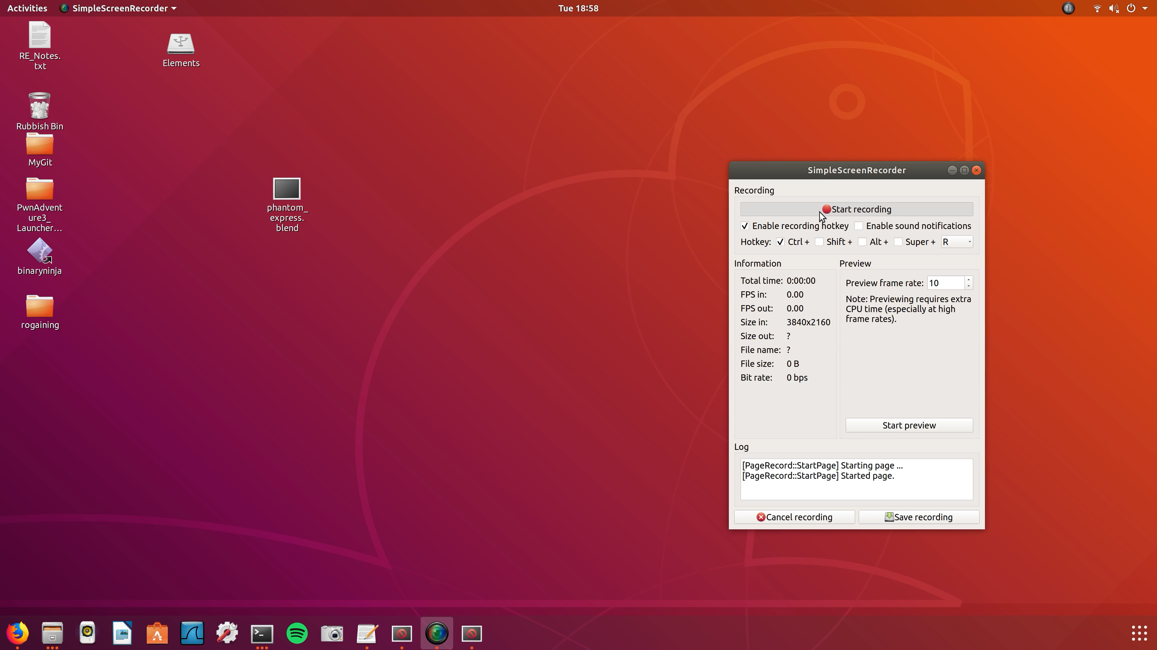

Slide 15
Go big or go home
Lets

Slide 16
Video of the DLC entering

Slide 17
What steps
Find part that implements DLC code
Read logic and see what checks it does
Generate a DLC code that passes all checks

Slide 18
It converted Letters into a corresponding number
E.g. “A” -> 10, “B”->11
Sum all numbers together and make sure last character was equal to the sum
Base32 encode the numbers together (remove zero padding)
Encrypt the first half of the DLC code with a RSA public key
Use a bit mask with the remaining DLC code and check to see if the output was equal to the ascii text “PWNADV3”

Slide 19
Show keygen

Slide 20
What did I learn
There are many tools that make reverse engineering programs easier than you think:
GNU Debugger (GDB)
Binary Ninja
dependency walker
IDA Pro
Don’t release a product with debug symbols
Not all compilers have the same level of security (e.g. clang and G++)
Binary files are more human readable than I first thought. They normally contain sections of human readable text (e.g. head section and any strings hardcoded into the binary).

